Slide 1
Introduction to Data Science in R
Pat Callahan
UCSF Memory and Aging Center
8/18/2020
Notes:
Everyone is going to be on mute by default
Feel free to ask questions in the chat, and please note the slide # that your question pertains to.
Data science is a massive field that I think can very broadly be split into understanding statistics and understanding coding
I think most people here are going to be familiar with simple frequentist or Bayesian statistics. Even if that’s not the case, I think there’s a lot of great mentorship available about the MAC regarding what kinds of statistical approaches to take, and how to learn about those.
The coding aspect of data science, however, isn’t always as clear cut. What language does everyone else use? What language should I use? How do I start learning a language? What are the best resources? How do I get things done quickly?
Goals
My presentation today is to briefly make the case for why you should be using R when it comes to data science,
From there, I’ll be covering a variety of topics that will help you better understand the R language and
Please, make note of topics where you think another presentation would be useful!

Slide 2
Presentation Goals
R and Data Science
Quick Start Guide
ImpoRtant Topics
Notes:
Can’t begin a discussion of R without introducing the idea of functional programming, for which R is heavily known
Goals
My presentation today is to briefly make the case for why you should be using R when it comes to data science,
I’ll give a quick start guide on basic, tangible things you’ll need to do in R
From there, I’ll be covering a variety of topics that will help you better use and understand the R language
My goal is not to give you all of the information on every topic; there’s simply too much to cover, and so I want to do what I can to tie together a lot of these disparate topics into a cohesive story about R and how to use it
More of a starter pack of topics I find to be of practical use
Some of the technical details I’ll give you are half-truths or white lies, and I’ll do my best to let you know when something is a rule vs. an expectation
Overall approach to this discussion is from a data science perspective
The first two goals will comprise today’s lecture, and the third goal will be next week’s topic

Slide 3
Functional Programming
Definition is arbitrary, and somewhat ethereal
Concept, !framework
Computation by evaluating functions
Programs written under assumption of (relatively) immutable data structures
X -> Y, always
Notes:
Some of you may have previously heard of object-oriented programming which is a mainstay concept in coding languages
It’s possible to do OOP in R, but it’s really known for being functional.
What does functional mean? Arbitrary concept, no hard-set definition; it’s a concept rather than a digital framework of some sort

Slide 4
History of R
Derived from the S language in the 90s
Initial 1.0 release February 2000 (Ihaka and Gentlemen)
Reached 4.0.0 in April!
Designed specifically as an open-source tool for statistical analysis
Extensibility
Notes:
Note that upgrading to 4.0 might cause problems. IF YOU ENCOUTNER A PROBLEM ON MacOS: I recommend deleting all R/RStudio installation files, and redownloading
Contact me if there’s a need for resources on how to do this

Slide 5
R Cons
Derived from S, but also implements C and FORTRAN
Technical debt; some oddities in code
Can have a steep learning curve
Base R function error messages can be obtuse
Ugly base graphs
Lost in a maze of packages
Notes:
If you’ve ever made a point plot or a line plot using base R, I hope you agree
If any of these are somehow a deal breaker, there are alternatives…

Slide 6
Alternatives
Python
MATLAB
JavaScript
Julia
SAS
Others

Slide 7
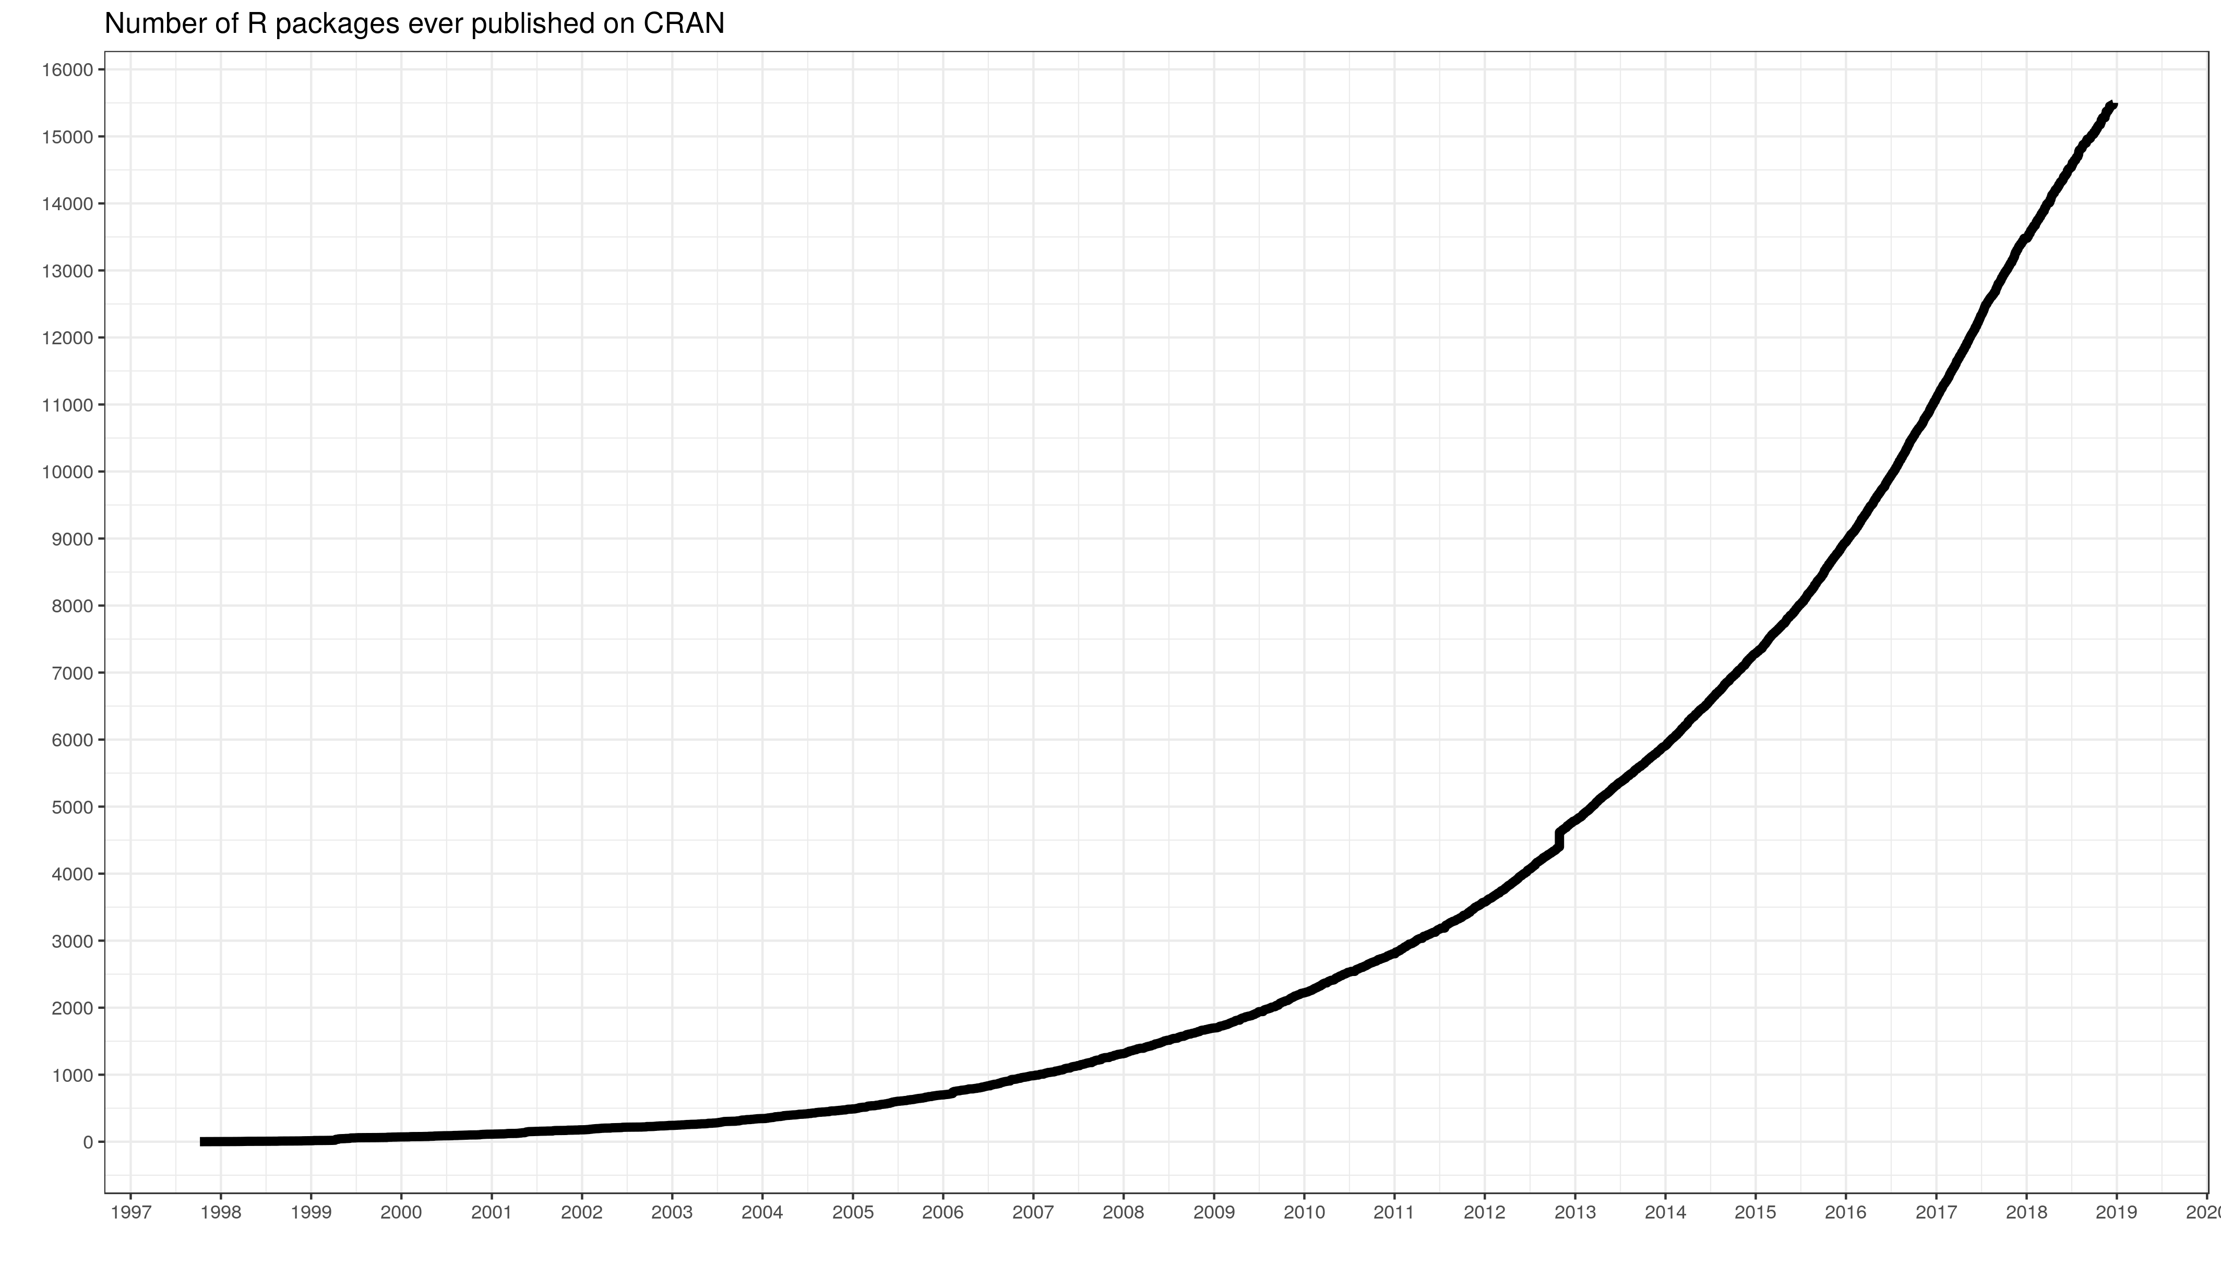
R Pros
$$$ Free! Now and always
Incredible documentation and help networks
Stack Overflow, RStudio Community, GitHub, etc.
Widely implemented in research and data science jobs
Widely-taught at the undergraduate level
Current and future colleagues will know R
13th most popular programming language overall
Open source packages
>15,000 total on CRAN
Variety of packages
Notes:
My understanding is that Berkeley has transitioned their data science program focus, and most of their biological sciences course, over to using R.
This parallels my undergraduate experience—a clear shift from MATLAB to R

Slide 8
Getting Started
Download R from the R Project website
Optional: download Xcode (Mac) or {rtools} (PC)
Needed for compiling some R packages
Download RStudio interactive development environment
Technically optional, but you’ll hate using the base IDE

Slide 9
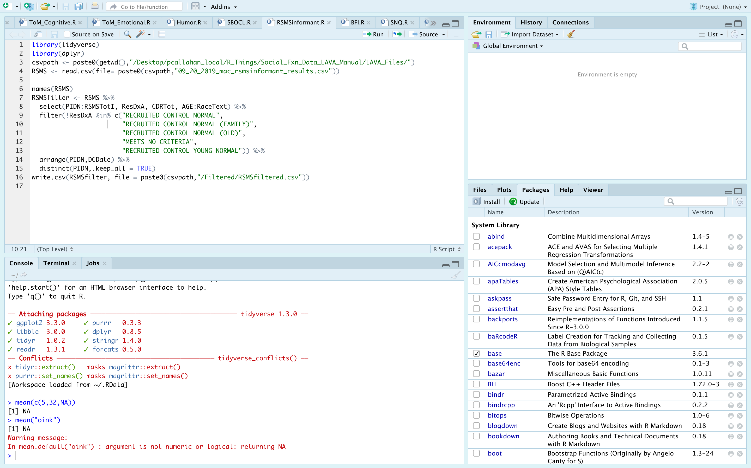
Notes:
Appearance of RStudio. You can ignore any specific text for now—I want to point out the 4 major panes…

Slide 10
Notes:
Four sections typically referred to as: source, environment, console, and viewer/help window
If you look closely, you’ll see that each of these panes have multiple tabs. I’ll discuss each tab generally, but the tabs currently open are the most commonly used.

Slide 11
Notes:
Source: contains all of your open .R and .Rmd files. Can run the entire script by pressing the Source button, or run line-by-line with Run

Slide 12
Notes:
Environment: shows all objects in your environment. In this case, I have no objects saved to my env!
History: shows the history of the lines you’ve run in this session
Connections: if you connect to a database a la a SQL connection

Slide 13
Notes:
Console: shows the code you just ran, and prints out the results of that code
Terminal: you can run bash or shell commands here
Jobs: tells you what, if anything, is running in RStudio. I never use this.

Slide 14
Notes:
Viewer/helper
Packages: shows you all of the packages you’ve downloaded and options to install/update
Files: shows you the files available in your current working directory
Plots: will show you any plots that you’ve generated using R during this session.
Help: frame that pops up when you call for help on a function. I’ll cover this later in the talk
Viewer: opens various R objects that aren’t plots or help files. Won’t be covered—separate topic

Slide 15
Simple R Syntax
Object assignment:
Use <- or =
Function calls:
Foo(.x, …)
Notes:
Start a note line using “#”
Reserved namespaces
TRUE, FALSE, if, NA, NULL, arithmetic operators (+, -, etc.)
Objects where the name starts with “_” or numbers
Case sensitive
Notes:
Should technically use the carrot-dash rather than equals when assigning variables due to some precedence rules that exist in R
Reserved namespaces == don’t try to create objects in R using these names

Slide 16
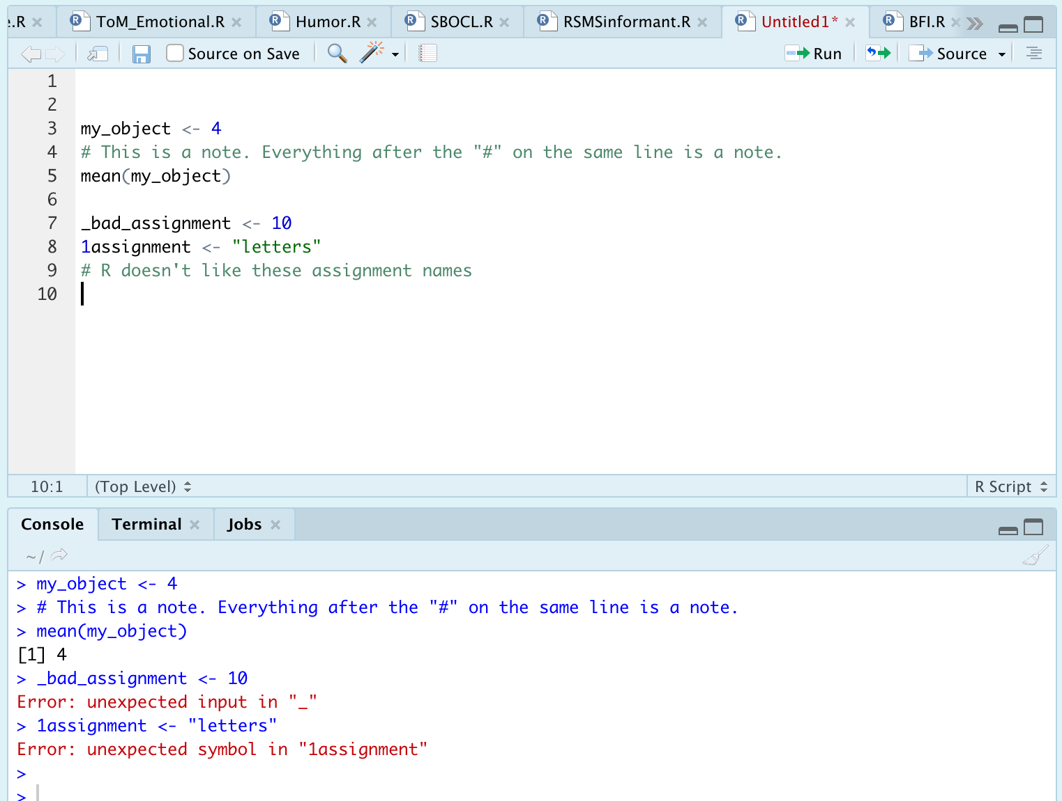
R Syntax: Examples
Notes:
In the Source area, I ran the script
Results came out in the Console
Let’s quickly review this line-by-line
Really important note: the assignments I’m creating are now known as objects
Keep that term in your head
A dataframe is an object, a single number is an object, a function is an object.
It’s a general term for something that exists in your R environment

Slide 17
R Infix Operators
Functions/methods enabling basic expressions
“Infix” refers to the placement of the operator between two variables
What you’ll care about in the beginning:
+, -, *, /, ^,>, <, >=, <=, ==, &, |
Complete list at http://applied-r.com/data-infix-operators-in-r/
Notes:
In most contexts, these infix operators represent their normal arithmetic operations
Infix list:
…
Single (assignment) vs. double (evaluation) equality sign
ampersand (&) and vertical bar (|)

Slide 18
Booleans
Represent the outcome of a binary evaluation statement
FALSE or TRUE
R also represents booleans as numeric values 0 and 1
This is done under the hood, but means you can perform calculations with boolean values
Notes:
Fancy way to say FALSE/TRUE situation

Slide 19
And/Or
Vectorized evaluations
The & operator is “and”
Each statement to an & statement requires explicit arguments. That is, `data = 4 & 5` is not valid while `data = 4 & data = 5` is
There is a short cut for some instances like this: %in%
The | operator is “or”
Same rules apply as in the “and” statements
&& and || are scalar versions of these statements
Returns only a single TRUE or FALSE statement

Slide 20
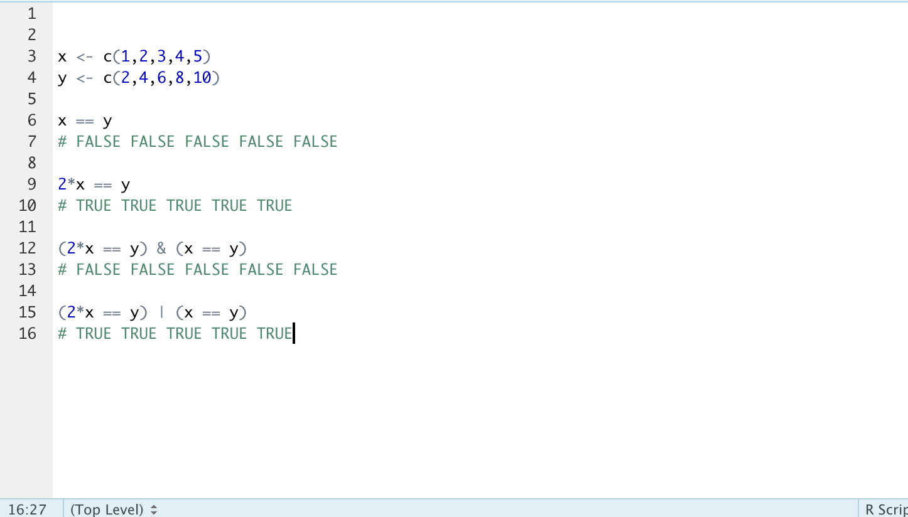
And/Or: Example
Notes:
Simple demonstration—can create significantly more complex evaluation
Creating two vectors of numbers
Note the use of c() and commas separating each number
Operation evaluates if each item in the vectors are equal
Obviously, they are not. Can perform math operation to make them true
Use of & and | operators

Slide 21
R Classes
What is a class?
Implicit object meta information
Alters how functions can/will treat the data
Why does this matter?
Troubleshooting and running functions!
What are the core classes in R?
Character, factor, numeric (integer or double) logical, raw, complex
Check classes with class()
Notes:
New topic! Object classes in R
Implicit because you rarely need to declare the class of an object. R guesses classes, and is usually pretty good at doing this.
Raw and complex grayed out because you will likely never see them
Important! Strictly speaking, classes aren’t the full story here, but they’re what really matters. The deeper underlying data structure is the “type” of the data
I find the information regarding “type” to be less informative, however, and troubleshooting ”class” is sufficient 99% of the time

Slide 22
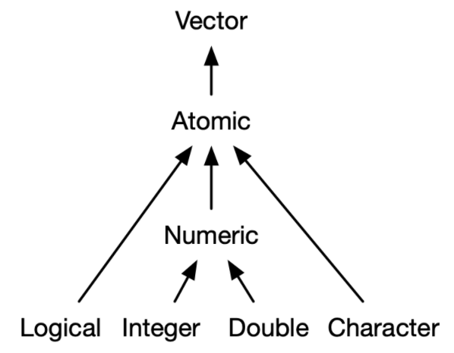
R Classes: Atomic Hierarchy
Most
specific
Least
specific
Notes:
I want to introduce this diagram right now; we’re going to revisit it with an in-depth discussion in a few slides.
Take some time to think about the specificity arrow, and how objects combine with one another

Slide 23
R Classes: Logicals
TRUE/FALSE values
Can use T and F as shortcuts
Stored as integers internally
0 = FALSE
1 = TRUE
Notes:
Completely straightforward
R represents TRUE and FALSE as integers under the hood so you can do math with them. With that, let’s review the numeric classes

Slide 24
R Classes: Numeric
Can be represented as either integer or double
Integers can be explicitly declared by typing “L”
Ex: the integer ten can be explicitly written 10L (not always required, but aids in clarity)
Really only impacts processing speeds, but important to know as you will see both
Notes:
Numeric is a catch-all for integers and doubles. You’ll probably see “numeric” listed most of the time, but good to recognize the sub-classes
Integers are, well, integers, Any whole, real numbers.
R processes integers a bit quicker, but it’s unlikely most of us are dealing with data where this is a concern
We are scientists, not mathematicians so we don’t need to respect integers
Doubles are any real numbers that aren’t integers

Slide 25
R Classes: Characters
Alphanumeric values (i.e. strings)
Numbers alone usually recognized as numeric
Numbers with letters will be set as character
Cannot perform mathematical operations on characters
Obvious, yes, but sometimes expected numbers are actually listed as characters
Can use string manipulation methods on characters
grep() functions
{stringr} package

Slide 26
R Classes: Factors
Often has a similar appearance to characters
Ex: c(“easy”, ”medium”,”hard”) are natively characters, but can be changed to factors
Store data in ordered levels
Declare with factor(x), and argument levels = …
R will use alphanumeric order if levels is unspecified
Why use factors?
Requirement for many functions
Notes:
Surprise topic!
Similar to character in that you will see strings printed out and words can still be read by you as a character class would
Many functions require certain variables to be factors.
A good example of when you’d want to make this change is with PIDNs on your datasets. Those are discrete variables, but R will read them in as numeric and thus continuous values.
Return to my earlier anecdote about classes vs types. This is one important place where you should have this anecdote in mind. It will save you a lot of time when working with factors

Slide 27
R Classes: Factors
Factors contain levels represented by numbers
Initial levels determined by alphanumeric order
*Underlying data structure is an integer!*
Class() = factor, but typeof() = integer
Help and troubleshooting
Base R: factor(), ordered(), and relevel() for help
{forcats} package, my recommendation
Notes:
Factors warrant their own discussion because of how important they will be for grouping analyses
Factor levels
Alphanumeric order is default; can be confusing
Factors can look like other classes when printed, but they will behave differently when we use functions
String manipulation on letters won’t work
Exercise: make a factor out of “easy” “medium” and “hard” to see the ordering results

Slide 28
R Classes: Important Functions
Will often need to check classes and convert between classes
Check classes
Class()
Is.factor(), is.numeric(), is.character(), as.logical(), as.date()
Change classes
factor(), as.numeric(), as.character(), is.logical(), is.date()
Notes:
Factors warrant their own discussion because of how important they will be for grouping analyses
Exercise: make a factor out of “easy” “medium” and “hard” to see the ordering results

Slide 29
R Structures: Vectors
Every object is a vector (for the most part)
Vectors are sequences of items of the same data type
WARNING: R will make every item be the same data type
”Atomic vectors”
Functions care about vector classes!
Notes:
We’ve reviewed the important types of classes. Why? To understand vectors
Idea of the atomic vector; that is, vectors where all elements are the same class

Slide 30
Remember me?
Most
specific
Least
specific
Notes:
So we’ve covered the order of specificity of these classes
You’ll see everything points to Atomic and then Vector
Vectors want to be atomic, and that just means everything in the vector is the same class

Slide 31
R Functions
In general, you supply an object and a set of arguments
Object is typically a vector or dataframe
Arguments should be named explicitly
R accepts positional and partial matching, however
Idea and syntax will be similar to most other programming languages
User-defined and built-in functions
Notes:
You should already be familiar with the idea of a function so I’m not going to cover this as a concerpt
I will talk about functions in R
What do I mean by explicit argument naming:
Example of a function that takes the arguments data, arg1, and arg2

Slide 32
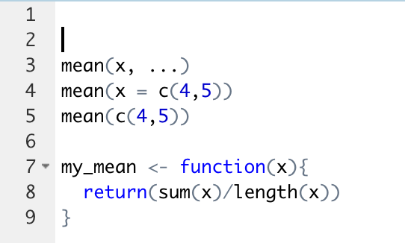
R Functions: Example

Slide 33
R Functions: For Loops
Can use for loops to iteratively generate values when needed
However, R is already a vectorized language
Objects are stored as vectors, and functions will process objects as such
Avoid for loops!
Comprehension
Speed, speed, speed
Notes:
I was taught for loops by my professors in undergrad, but they probably learned to do these in other languages where it makes sense so it’s a place where I depart drastically.
In summary, I will delete your code if you write a for loop

Slide 34
R Structures: Lists
Can be thought of as similar to a vector except all objects retain their identities
Ex: list(1, TRUE, “character”, factor(hello, goodbye))
Objects in a list can be anything: a vector, a single number, multiple data frames
Lists can contain lists!
Powerful feature useful for iterative processes, nested data, and other situations
Notes:
In the example, all of the objects retain their identity. 1 is numeric, TRUE is a logical, character is well a character, and hello/goodbye are factors.
If this were a vector, however, everything would have been reduced to the lowest common denominator which is a character
Lists aren’t a huge deal for our purposes because most of you will be working with flat files, but you’ll encounter them more as you get more advanced

Slide 35
R Structures: Matrices & Arrays
Matrix: unlabeled N x M data space
Transposable (if ever needed)
Useful for speed + efficiency
Must be atomic
Array: stacked matrices
Notes:
Again, going to disrespect mathematicians here. There’s not much use for matrices and arrays in most of our work unless you’re working with ultra high-dimensional data

Slide 36
R Structures: Data frames
Bread and butteR of data representation
csv, .xlsx, .rdata
Generic term for storing data in a 2D format
Rows = observations, columns = variables
Implemented in a variety of packages and manners
Generic R method, {data.table}, {tibble}
How do I know what kind of data I have?
Class() fxn
Dependent on package used to read-in data

Slide 37
*Tibbles*
Base R data table structure
stringsAsFactors = TRUE
Printing method (ugly)
Data.table
Fast
Still ugly
Tibbles
Simultaneously data frame, data table, and tibble
stringsAsFactors = FALSE
Designed to work with {tidyverse}
Superior print method
Notes:
I previously mentioned that R has some baggage associated with it
Base data frame sets stringsAsFactors = T (super annoying), prints the whole object
Keep an eye out for the vroom package

Slide 38
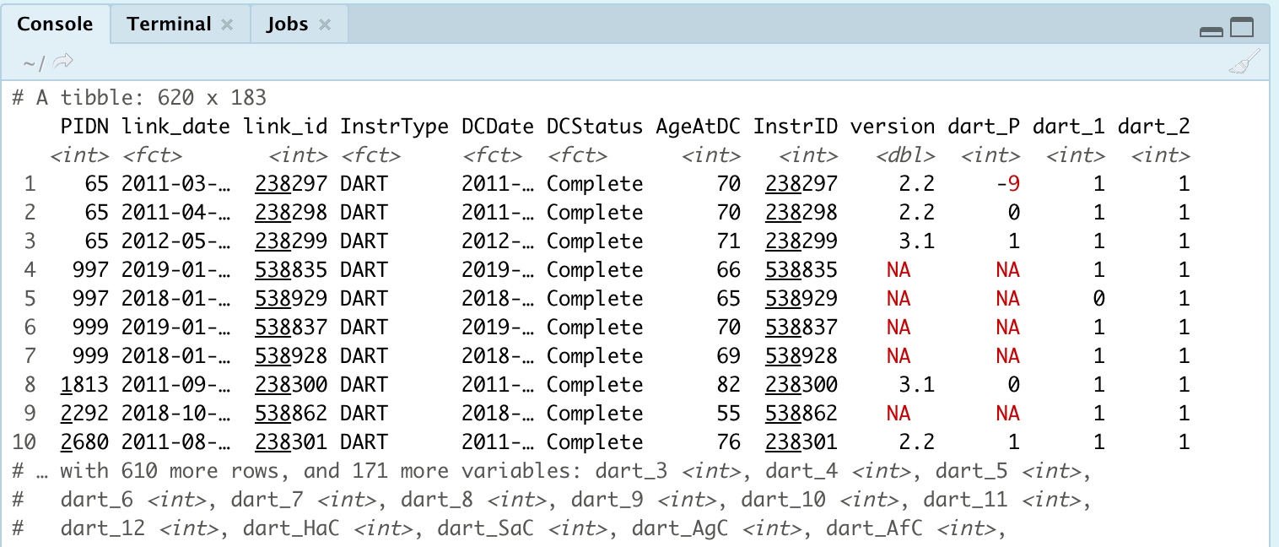
Tibbles: Example

Slide 39
Learn {tidyverse} over any/all other packages
Notes:
Structure your learning around this
It is hands-down the most complete and most used ecosystem of packages
You will understand SO and RStudio community questions infinitely better when you see that most questions involve or include fxns from the tidyverse

Slide 40
Other Packages, Discovering Data, and Troubleshooting
Notes:
Finished with our main presentation, and going to move on to some closing thoughts and things I think will be beneficial

Slide 41
Other Packages to Consider
{apaTables}
{broom}
{tidyr}
{usethis}
{purrr}

Slide 42
Exploration Tools
Look at your table in Excel or using View()
Quantitative information
str()
summary()

Slide 43
Help! (I need somebody!)
?foo or help(foo)
?foo or help(foo)
?foo or help(foo)

Slide 44
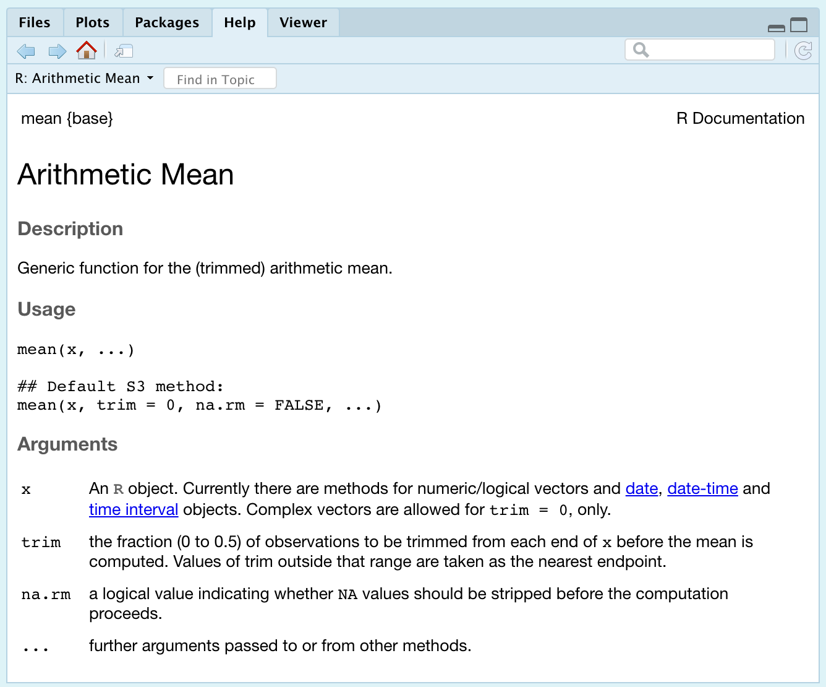
Help! Example

Slide 45
Help! Other Options
Vignette()
Google
Stack Overflow + RStudio Community
GitHub (tread lightly)

Slide 46
Troubleshooting: Clearing Environment
Package conflicts/masks
Declare packages with their functions
Ex: filter() or filter()
Too many objects in the environment to keep track of
Useful cleaning functions
rm( list=ls() )
.rs.restartR()

Slide 47
My Recommended Resources
Online:
Roger Peng and John Leek on Coursera
DataCamp (free and paid options)
https://homerhanumat.github.io/r-notes/index.html
Books:
Beyond Spreadsheets with R
R in Action
In R:
swirl()
RStudio cheatsheets
Notes:
Other books you might encounter:
R 4 Data science: don’t recommend for beginners, but is solid
R in Action 3rd edition: this is a good 2nd book to read
Most books from Manning Publications website are solid
Haven’t fully verify the book by Homer Hanumat, but it was updated just a month ago and seems to cover all the important topics

Slide 48
Questions?
Slides available on my GitHub, NeuroShepherd, in the R_Coding_Presentations folder
Video recording from today’s session will be posted

